Slide 1
Chlorophyll distributions and nutrient transport in relation to physical processes off Long Bay, South Carolina, USA, in the winter of 2012
PhD Dissertation Proposal Stephen Lockhart
March 22, 2017

Slide 2
Outline
Introduction
Background
Instruments and Methods
Observations
Synthesis and Conclusions
i.e. what papers I need to write

Slide 3
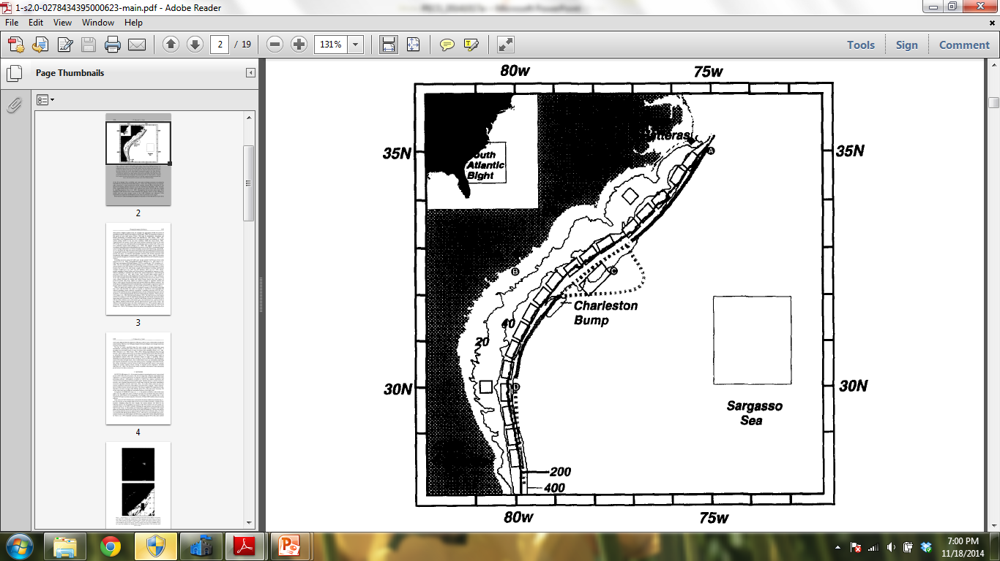
Introduction Motivation for the Long Bay Study
Long Bay
#13
#11
Adapted from Ryan and Yoder (1996)
Notes:
Prior research that motivated the Long Bay 2012 filed program includes the work by Ryan and Yoder (1996). They analyzed 7 years of satellite images, carving the data into bins along the slope (40m to 200m). Here, I’ve indicated their bin numbers that fall in Long Bay (11-13).

Slide 4
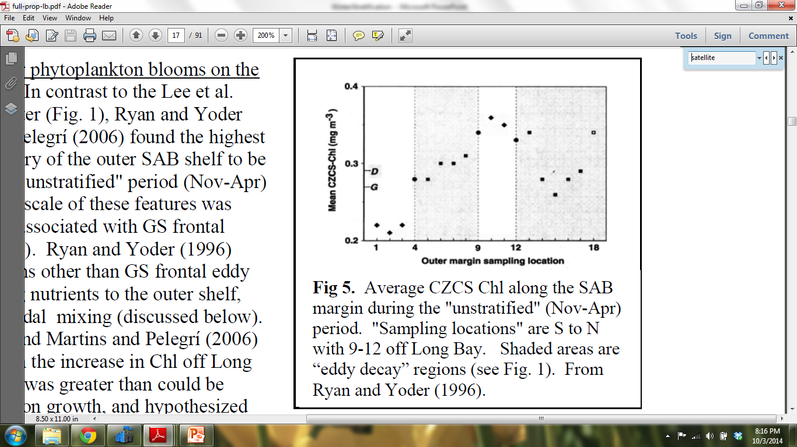
Introduction Motivation for the Long Bay Study
Nov-Apr
over 8 years
Fig. 2. Mean unstratified period CZCS-Chl for all outer margin sampling locations (1 to 18 from S to N). Frontal eddy decay regions are shaded. Means of stations falling on a boundary between eddy growth and decay regions are marked by circles. Due to the large number of observations that went into the calculation of each mean, 95% confidence intervals are too small to be seen. The G and D symbols mark the pooled means for eddy growth and decay regions.
From Ryan and Yoder (1996)
Notes:
They found high wintertime productivity (as measured by surface Chl-a from November through April) in several bins downstream of the Charleston bump, including the bins that fall in Long Bay. So, the interesting question is: why is there high wintertime productivity off of Long Bay?

Slide 5
Introduction Focus of dissertation
Describe the blooms.
What was the distribution of chlorophyll (in space and time) on the shelf and slope in Long Bay?
Estimate the export of chlorophyll from the shelf to the slope.
What caused the blooms?
What was the distribution of nitrate (in space and time) on the shelf and slope in Long Bay?
What physical processes contributed to the observed distribution of nitrate?
Estimate transport of nitrate (up-slope, shoreward)

Slide 6
Background Outline
Strong atmospheric forcing
Stratification
Influence of Gulf Stream
Nutrient transport from slope to shelf
Wind-driven Ekman flow
Internal waves
Distribution of Chlorophyll
Resuspension of Sediment
Notes:
Before describing the Long Bay field program, I’d like to provide some more background on this region of the SAB from some previous studies.

Slide 7
Background Atmospheric Forcing
In the winter, cold air outbreaks (CAO) meet the Gulf Stream, causing intense exchanges of heat, moisture, and momentum (Bane and Osgood, 1989).
Driven by strong atmospheric forcing, “deep mixing” could bring nutrient-rich slope water closer to the surface (Atkinson et al., 1996).

Slide 8
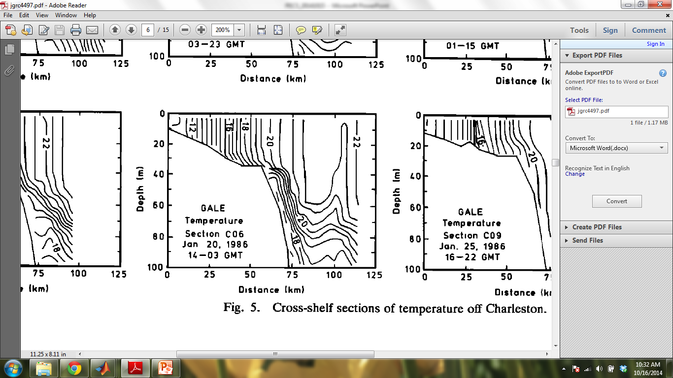
Background Stratification
Fig. 5 from Atkinson et al. (1989) shows horizontal stratification, but they did see some strong stratification events due to:
Wind-driven Ekman flow and/or
Intrusions of buoyant water from Gulf Stream meanders (Atkinson et al., 1989)
Notes:
The shallow water cools more than the deeper water, resulting in a horizontal temperature gradient across the shelf in the winter, as seen here in one of the GALE-related studies. Nevertheless, they did see several strong stratification events, due to either wind-driven Ekman flow and/or surface intrusions of buoyant water from Gulf Stream meanders.

Slide 9
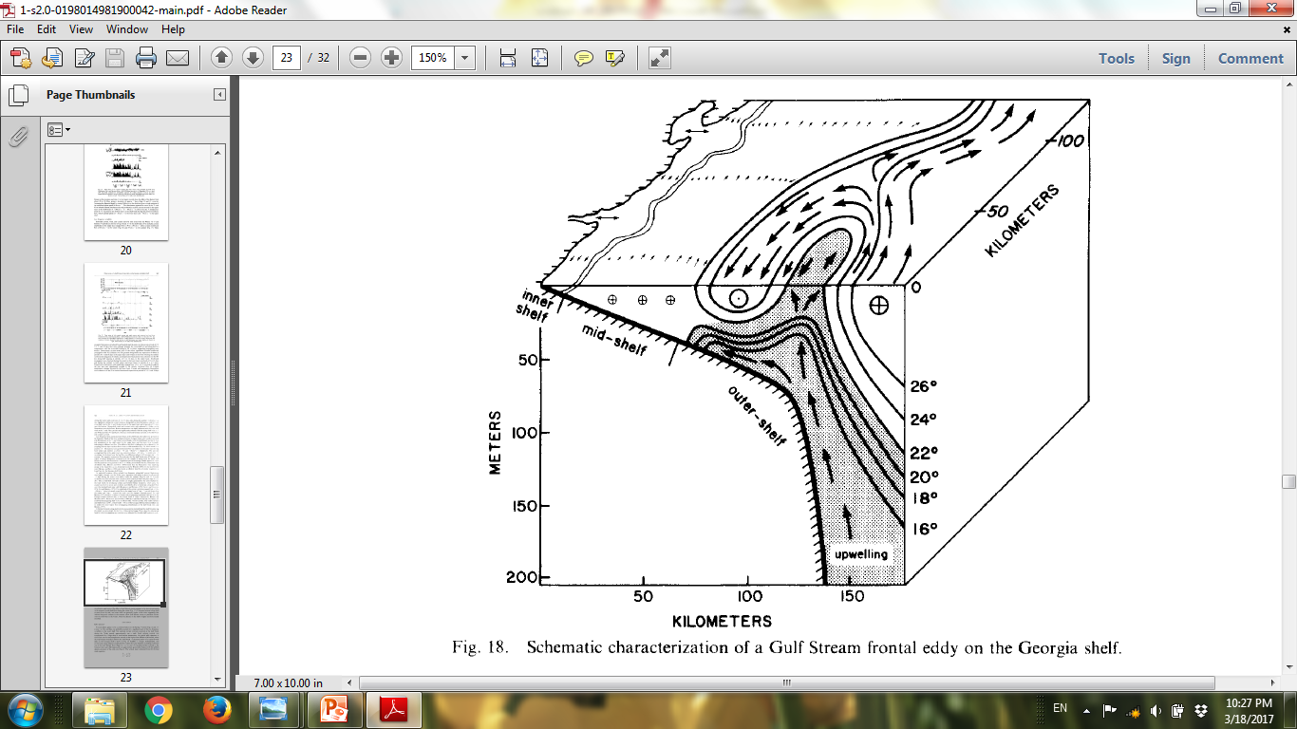
From Lee et al. (1981)
Notes:
Here’s a nice schematic of a frontal eddy, showing a “wrap-around” filament, peeling off from a meander crest. The circulation between the filament and the Gulf Stream itself is cyclonic, causing upwelling of nutrient-rich water. Depending upon strength of the “wrap-around” flow compared to the rate of propagation of this feature downstream, there may or may not be a net equatorward flow in the filament.

Slide 10
Background Gulf Stream
Long Bay
#13
#11
Adapted from Ryan and Yoder (1996)
Notes:
Going back to this slide from Ryan and Yoder (1996), they are showing the mean position of the Gulf Stream in a dashed line in regions of frontal eddy growth and a solid line in regions of frontal eddy decay. They also indicate the two modes of the Gulf Stream downstream of the Charleston bump. They cite Bane and Brooks (1979) for these features.

Slide 11
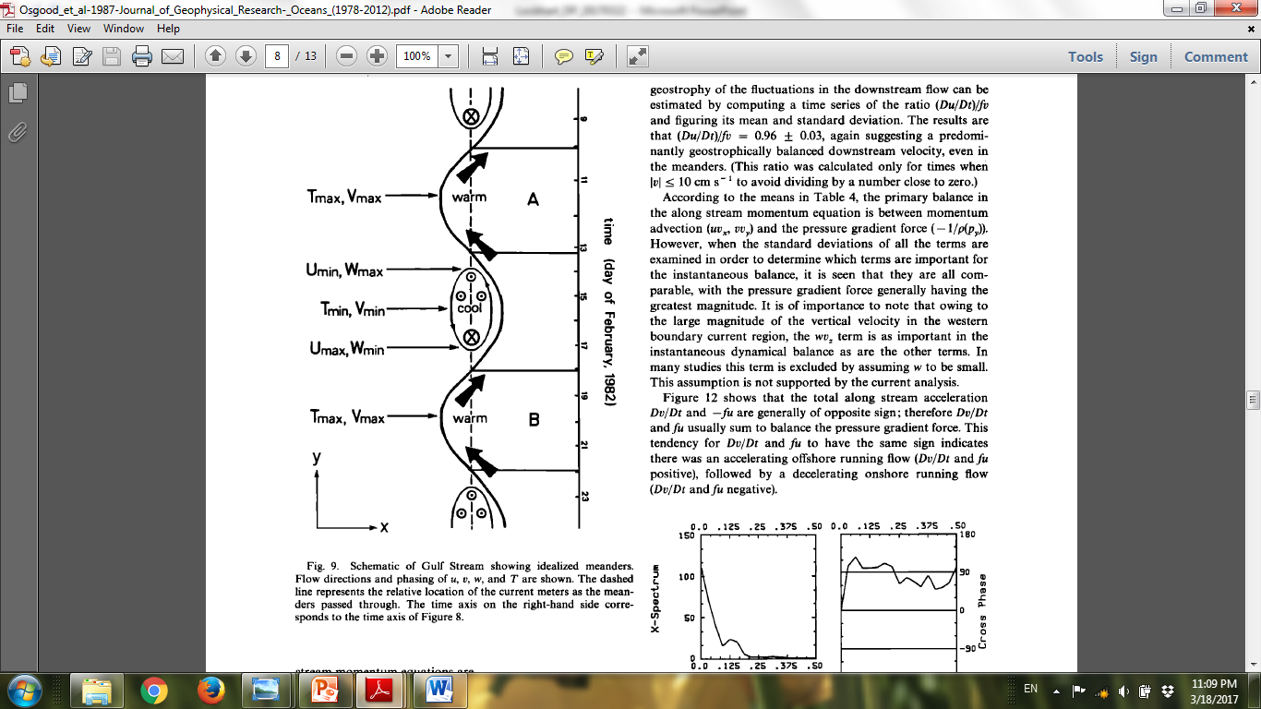
From Osgood, Bane, and Dewar (1987).
From Lee et al. (1981)
Notes:
I would also like to point out that there is upwelling related to meanders even without a wrap-around filament. On the shoreward side, on the way to the meander crest, there is upwelling.

Slide 12
Background Transport of Nutrients
In Jahnke and Blanton (2010), they estimated that the greatest source of nitrogen to the SAB continental shelf is “shelf–edge upwelling” (by about an order of magnitude over other sources, like riverine, atmospheric, groundwater).

Slide 13
Background Transport of Nutrients
Upward transport of nutrients could be driven by:
Meanders
Filaments (cyclonic gyre between filament and GS)
Strong air-sea interactions (causing deep mixing)
Shoreward transport of nutrients could be driven by:
Meanders
Filaments (dissipating on the shelf)
Ekman flow
Internal waves
Notes:
It may be a little forced and artificial, but when organizing all of this, I’ve tried to highlight some processes that bring nutrient-rich water up to the surface and other processes that then transport the upwelled water further shoreward. Regarding shoreward transport, I’ll focus more on Ekman flow and internal waves here.

Slide 14
Background Gulf Stream Influence
This figure was copied from Oey et al. (1987), their Figure 4. It depicts wind-driven “transient upwelling” at the western edge of the Gulf Stream.
Notes:
Really a 2-D picture of Ekman flow. It is interesting to note that Oey et al. (1987) did not have evidence of increased nitrate in the shoreward Ekman flow. In a related GALE paper, Atkinson et al. (1996) did find a “weak relation between amounts or concentrations of nitrate and wind stress.”

Slide 15
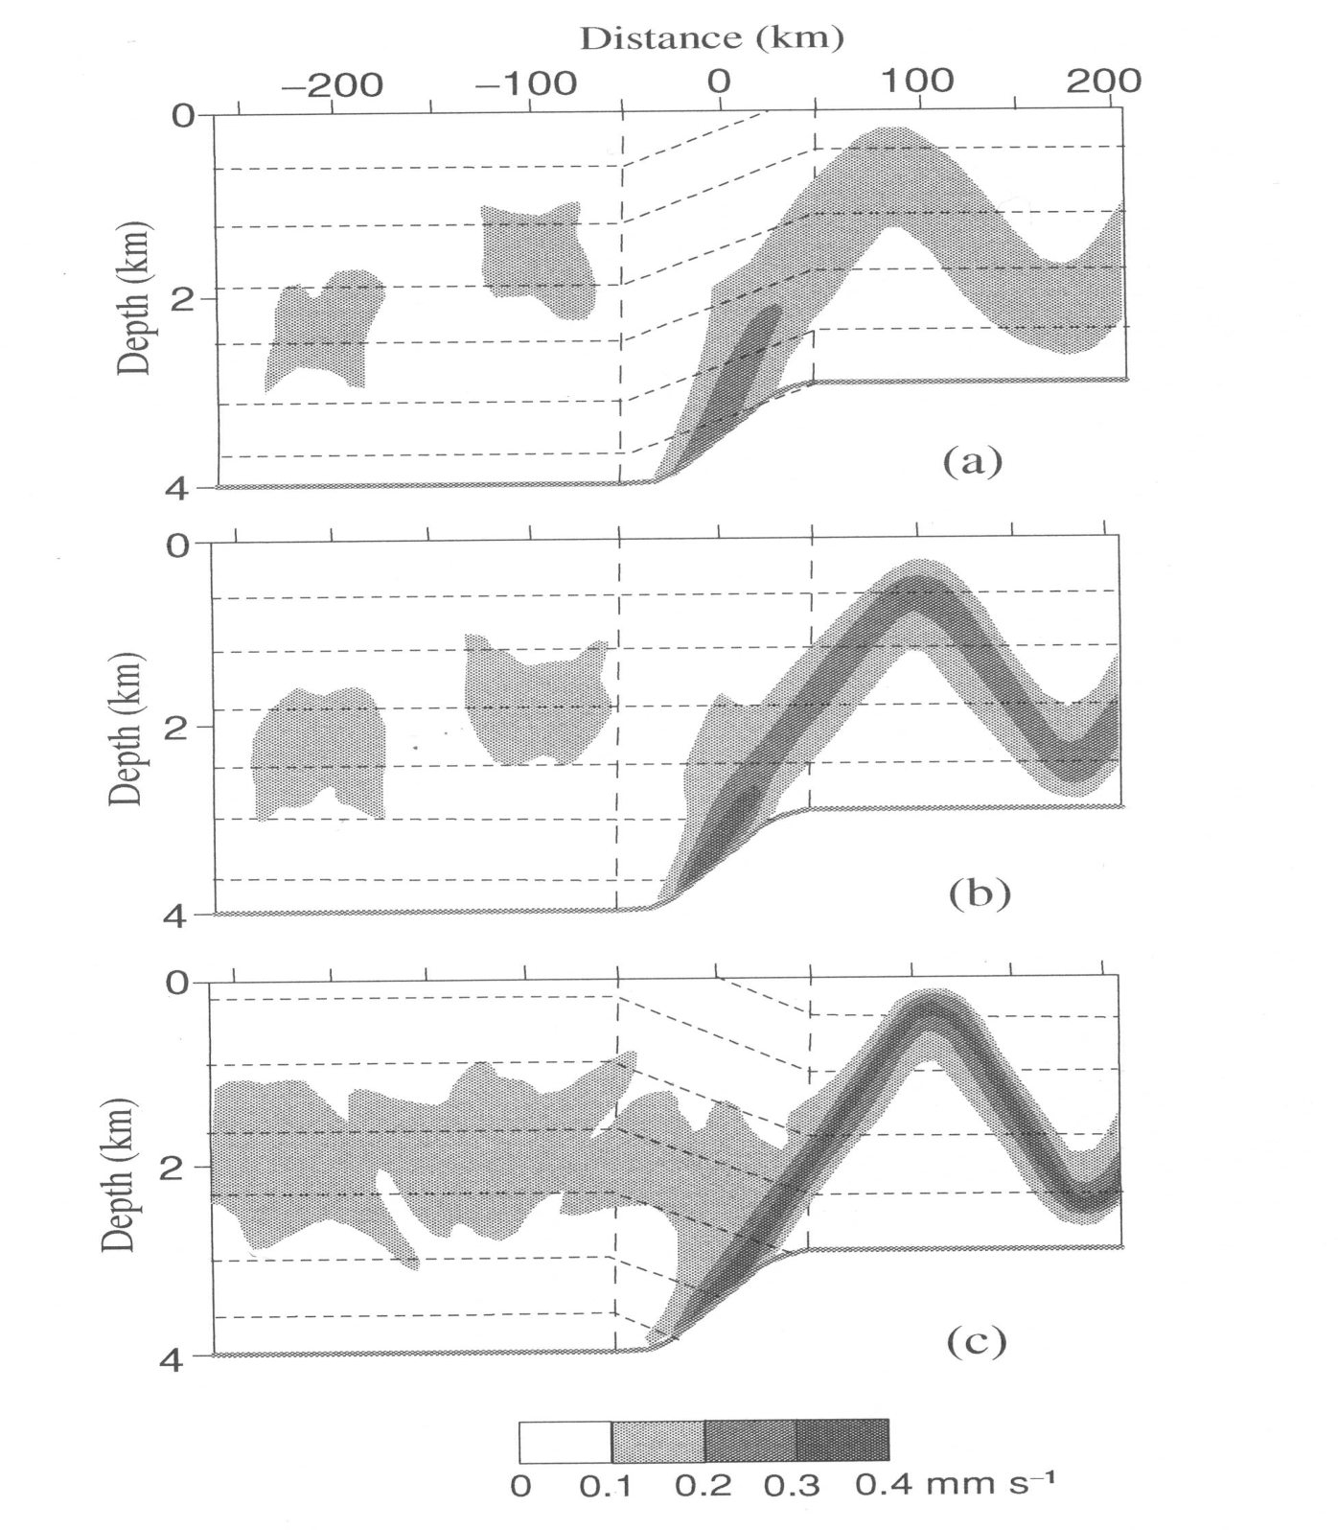
From Figure 3.19 in Vlasenko et al. (2012)
Notes:
Fig. 3.19 from Vlasenko

Slide 16
Background Distribution of Chlorophyll
Consider the following factors:
Availability of light
Availability of nutrients
Grazing, falling to bottom
Advection
Resuspension of sediment

Slide 17
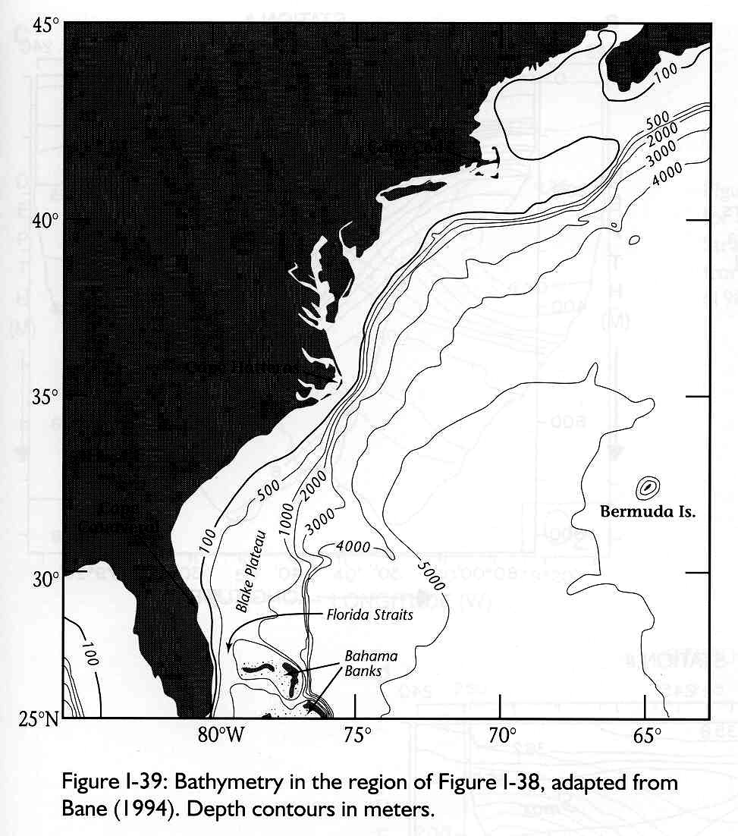
Instruments and Methods Overview of Long Bay Field Program

Slide 18
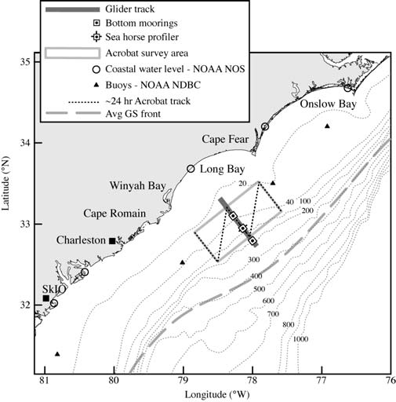
Instruments and Methods Overview of Long Bay Field Program
Towed body (Acrobat)
2 gliders (Pelagia, Ramses)
3 moorings on mid-transect
Thermistor chain at LB1
LB1
LB2
LB3
Buoy
41004
Notes:
Indicate sensors per platform. Indicate where gliders went (or were supposed to go). Indicate where Acrobat went.

Slide 19
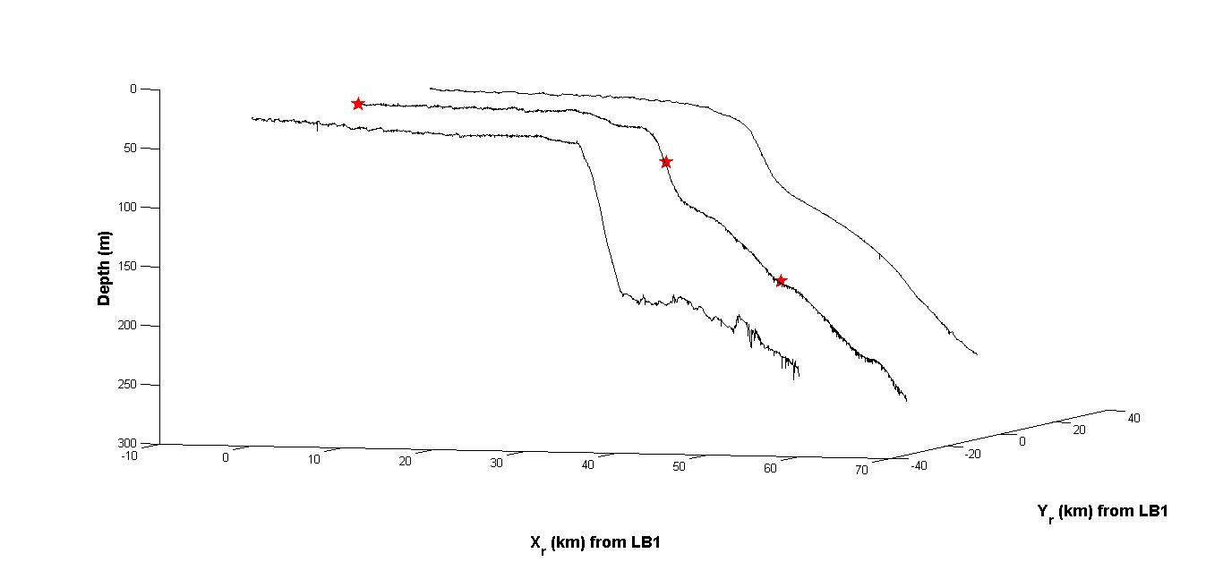
Instruments and Methods Overview of Long Bay Field Program
LB1
LB2
LB3
Notes:
Indicate depth of each mooring. Indicate what the slope is on south transect. Point out that transect views of measured fields will show distance from LB1.

Slide 20
Instruments and Methods Overview of Long Bay Field Program
 | Gliders (2x) | Moorings (3x) | Temperature Chain (1x) | Towed Body (1x) | Ship
T | x | x | x(25) | x | x
S | x | x |  | x | x
Chl-a | x | x | x(3) | x* | x
DO | x |  |  | x | x
u,v |  | x |  |  | x
NO₃⁻ |  |  |  | x
PAR |  |  |  | x | x
CDOM | x |  |  |  | x
scatter | x |  |  |  | x
turbidity |  | x |  | x
+Air-sea interaction data from NOAA Buoy 41004, CERES
+Satellite images of SST, Chl

Slide 21
Instruments and Methods Overview of Long Bay Field Program
 | Gliders (2x) | Moorings (3x) | Temperature Chain (1x) | Towed Body (1x) | Ship
T | x | x | x(25) | x | x
S | x | x |  | x | x
Chl-a | x | x | x(3) | x* | x
DO | x |  |  | x | x
u,v |  | x |  |  | x
NO₃⁻ |  |  |  | x, ?
PAR |  |  |  | x | x
CDOM | x |  |  |  | x
scatter | x |  |  |  | x
turbidity |  | x |  | x
+Air-sea interaction data from NOAA Buoy 41004, CERES
+Satellite images of SST, Chl

Slide 22
Instrumentation and Methods Overview of Long Bay Field Program
 | Gliders (2x) | Moorings (3x) | Temperature Chain (1x) | Towed Body (1x) | Ship
T | x | x | x(25) | x | x
S | x | x |  | x | x
Chl-a | x | x | x(3) | x* | x
DO | x |  |  | x | x
u,v |  | x |  |  | x
NO₃⁻ | ? |  |  | x
PAR |  |  |  | x | x
CDOM | x |  |  |  | x
scatter | x |  |  |  | x
turbidity |  | x |  | x
+Air-sea interaction data from NOAA Buoy 41004, CERES
+Satellite images of SST, Chl

Slide 23
Observations
Distribution of Chl-a in space and time
Up-slope transport of nitrate
Physical processes
Gulf Stream Influence (meanders/filaments/jets)
Internal Waves

Slide 24
Observations Distribution of Chl-a in Space and Time
Observations
Where and when did we see blooms on the shelf/slope
Satellite images
Time Series of Chl-a (from moorings, thermistor chain)
E.g. 3 depths at LB1
Transects of Chl-a (from gliders and Acribat)
E.g. 5 x Pelagia March 14 – April 1
E.g. 2 x Ramses March 26 –April 1
Profiles from Savannah casts
T-S plots color-coded with Chl-a (provides another view)

Slide 25
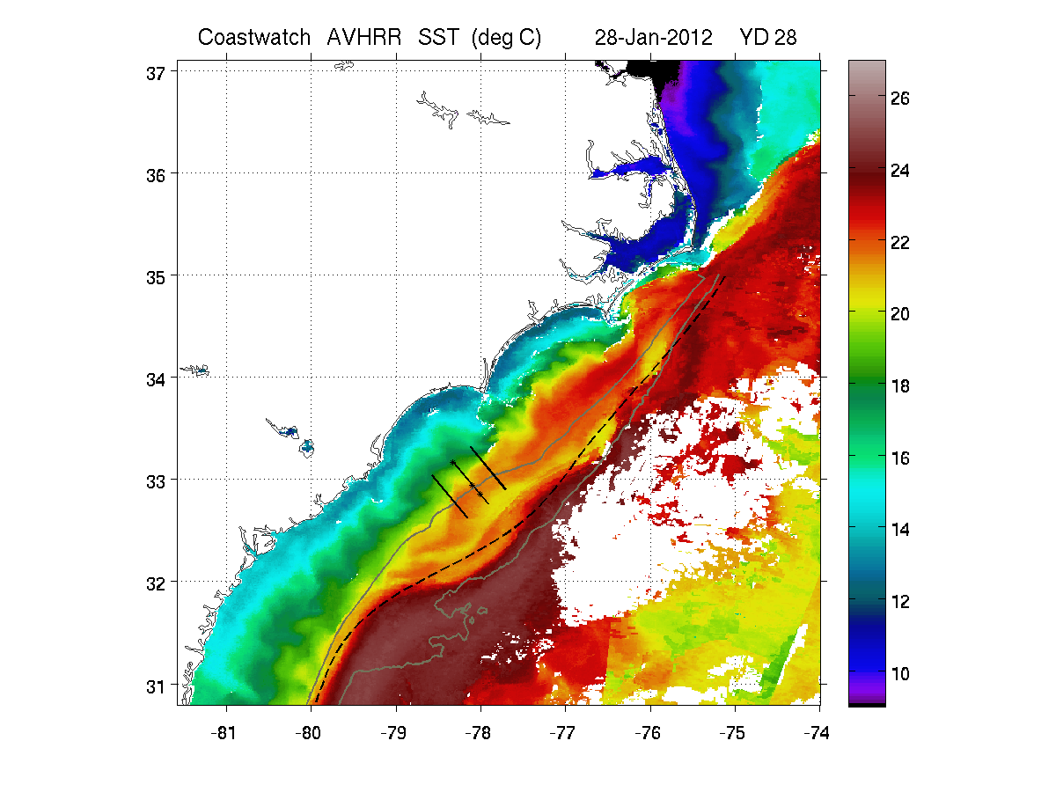
Observations SST January 28, 2012
Notes:
The dashed line shows the average position of the Gulf Stream front (Miller, 1994). Also shown are the 100m and 600m isobaths.

Slide 26
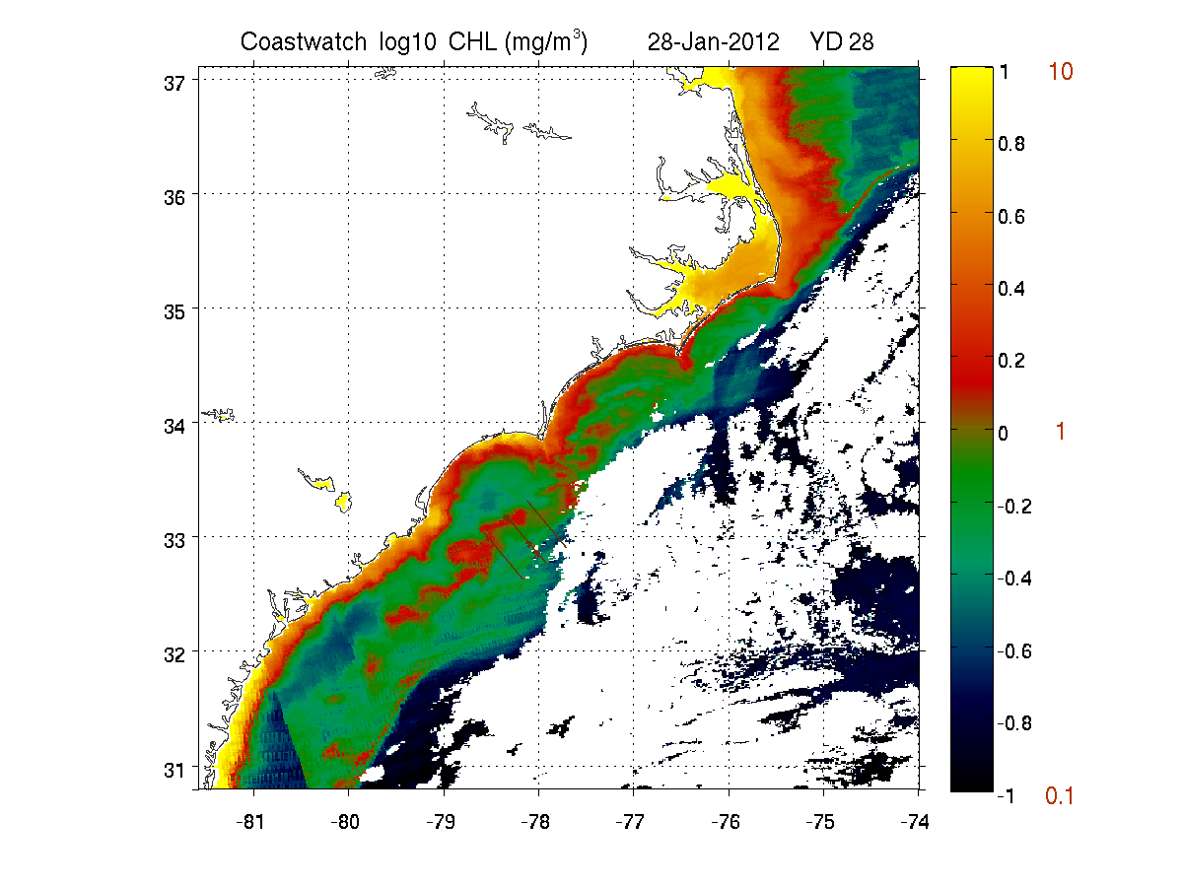
Observations Chl-a January 28, 2012
Notes:
Reminiscent of Ryan and Yoder’s 700km band, driven either by wind or tidal forcing.

Slide 27
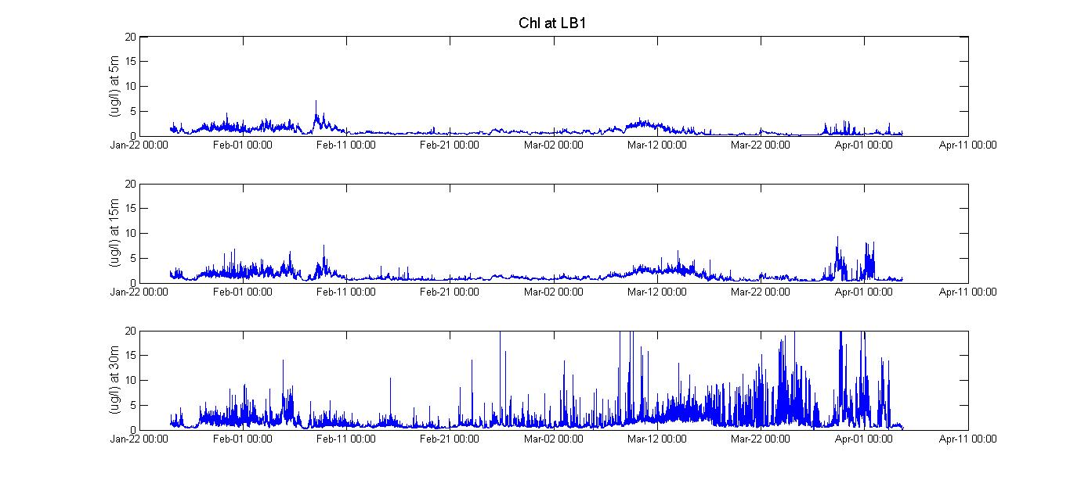
Observations Time Series of Chl-a: 3 Depths at LB1

Slide 28
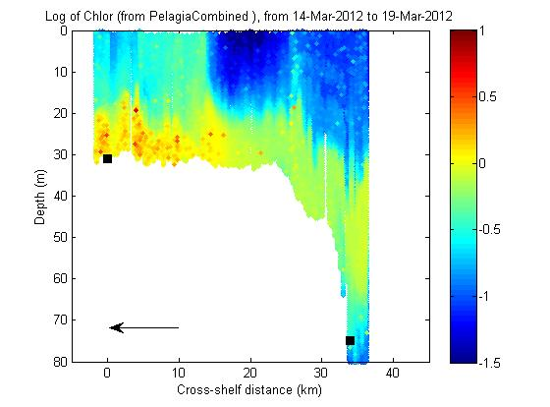
Observations Glider Transects of Chl-a: Pelagia

Slide 29
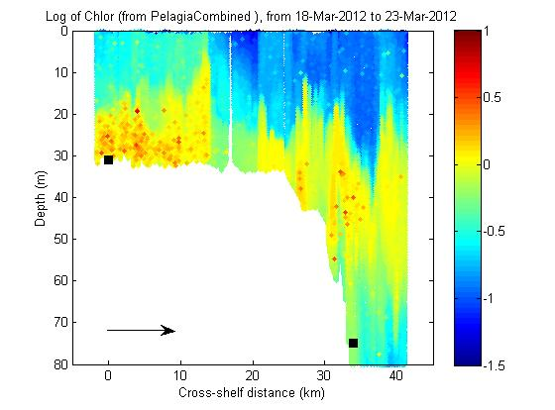
Observations Glider Transects of Chl-a: Pelagia

Slide 30
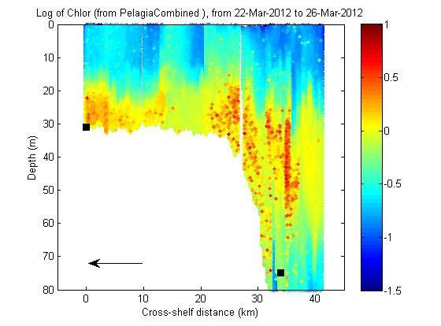
Observations Glider Transects of Chl-a: Pelagia

Slide 31
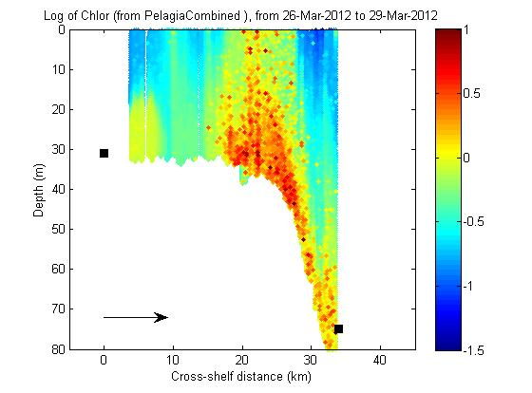
Observations Glider Transects of Chl-a: Pelagia

Slide 32
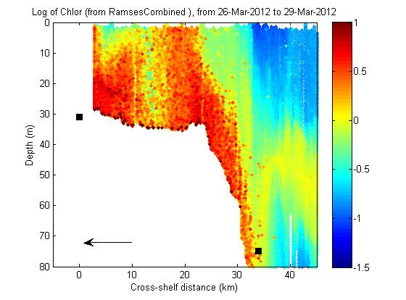
Observations Glider Transects of Chl-a: Ramses

Slide 33
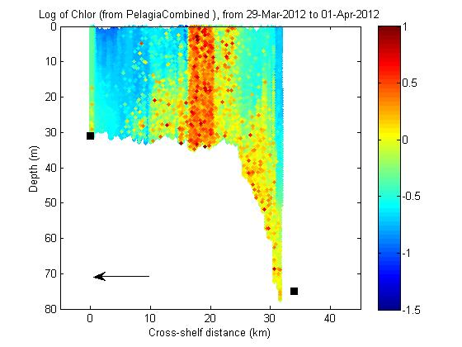
Observations Glider Transects of Chl-a: Pelagia

Slide 34
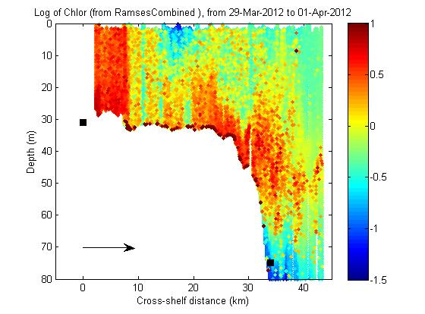
Observations Glider Transects of Chl-a: Ramses

Slide 35
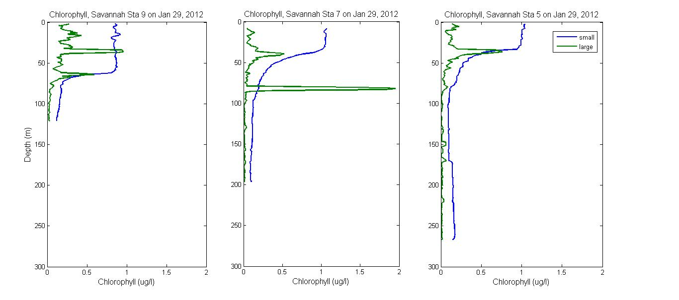
Observations Profile of Chl-a: Savannah casts

Slide 36
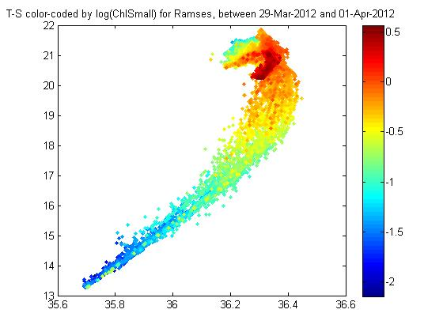
Observations T-S plots color-coded by Chl-a
Notes:
An example…e.g. after segmenting Chl into “Large” and “Small”, can see water properties, so this is a tool I’ll be using to try to figure out the distribution of Chl-a.

Slide 37
Observations Distribution of Nitrate in Space and Time
Observations
Where and when did we see nitrate on the shelf/slope
Transects of measured nitrate (Acrobat)
Transects of estimated nitrate (gliders)
T-S plots color-coded with nitrate (provides another view)
For each instance of up-slope transport, correlate to physical processes
Wind-driven Ekman flow
Internal waves
Presence of Gulf Stream features (meanders/filaments/jets)

Slide 38
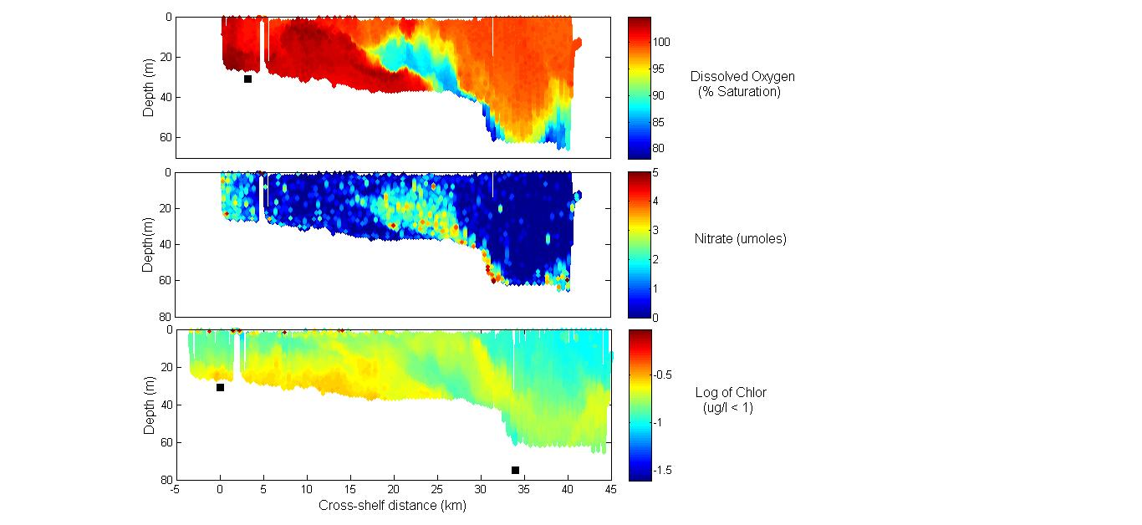
Observations Example of Up-slope transport (March 18S)

Slide 39
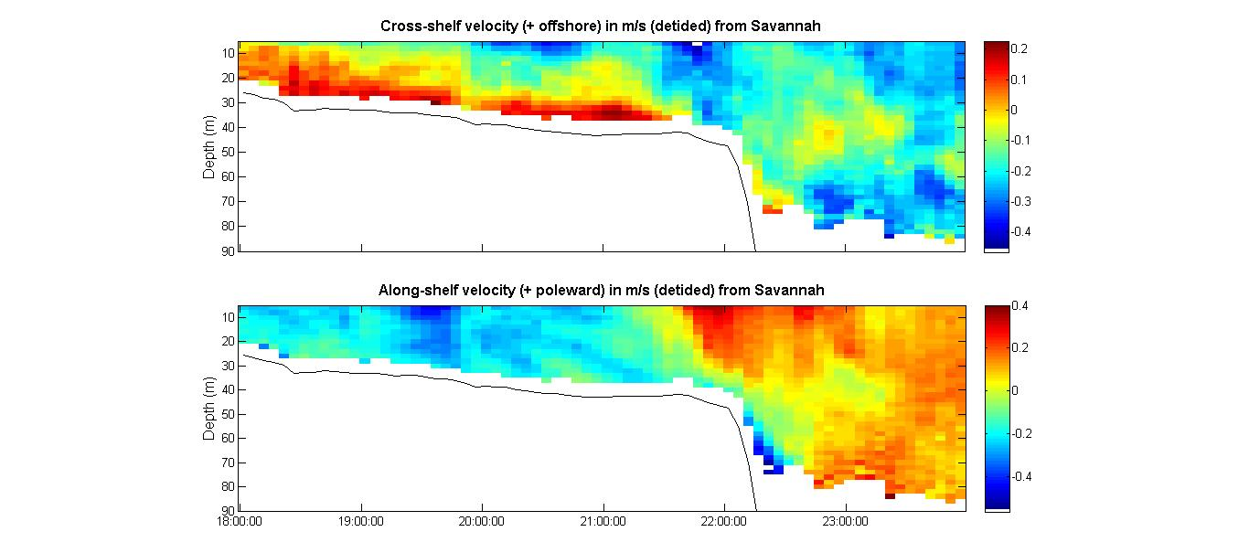
Observations Example of Up-slope transport (March 18S)

Slide 40
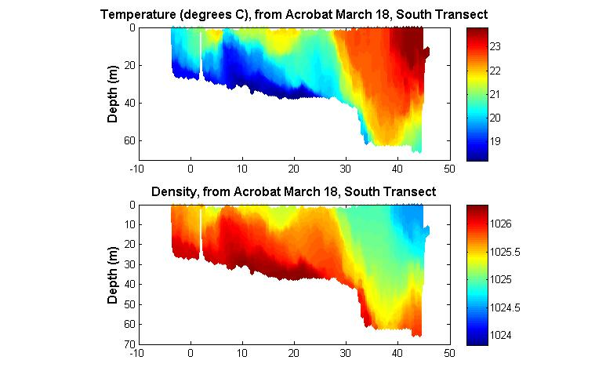
Observations Example of Up-slope transport (March 18S)

Slide 41
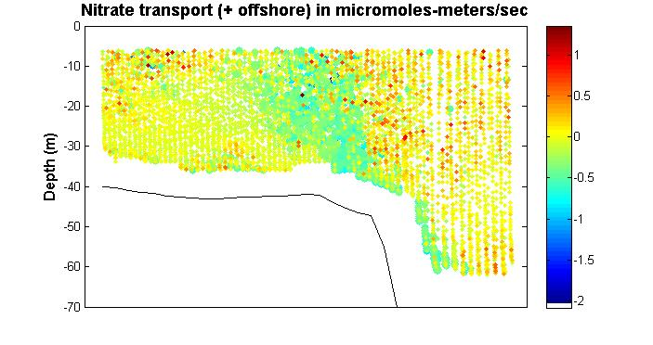
Observations Example of Up-slope transport (March 18S)

Slide 42
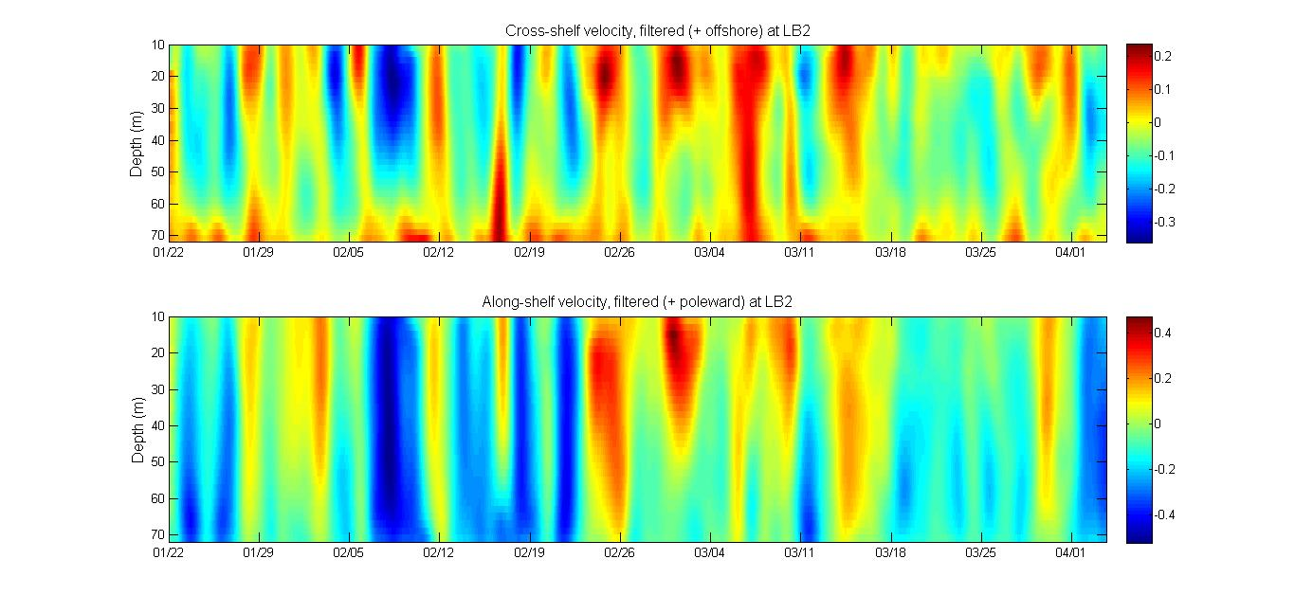
Observations Gulf Stream Influence: Velocity at LB2 (Depth vs. time)
J1
J2
Meanders
F1
Late March

Slide 43
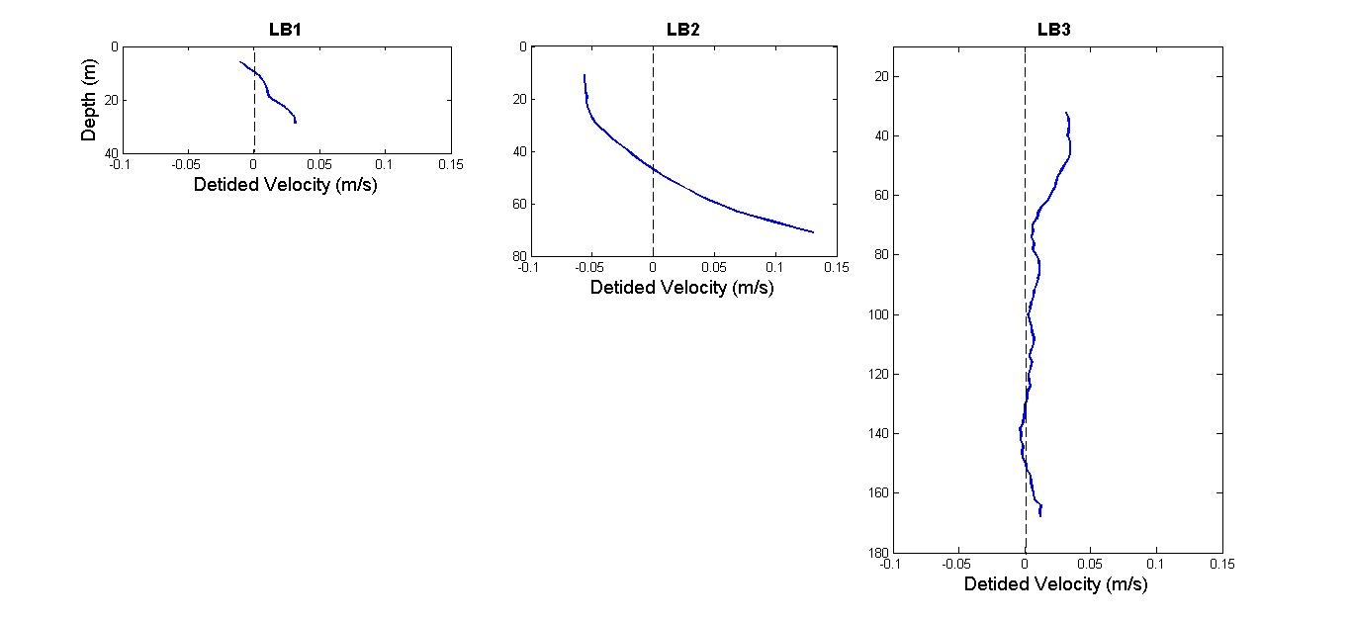
Observations Time-Averaged Cross-shelf Velocity Profiles
Notes:
Should we use detided…

Slide 44
Observations Gulf Stream Influence: Velocity at LB2 (Depth vs. time)
J1
J2
Meanders
F1
Late March
Notes:
Just going back to this view before we look at satellite view of J1

Slide 45
Observations SST Image 1/28/2012
Notes:
See jet from J1 time period going across our mooring array. The dashed line shows the average position of the Gulf Stream front (Miller, 1994). Also shown are the 100m and 600m isobaths.

Slide 46
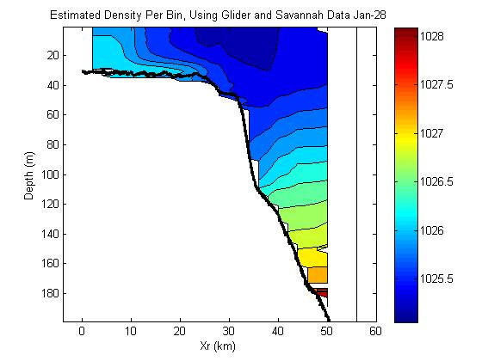
Observations Density Field (1/28/2012) from Objective Analysis
Notes:
OA combining glider and savannah data shows mass field like “summer front” when the jet is present (during J1). J2 and “Late March” would be similar. Go over thermal wind equations, esp. in this case.

Slide 47
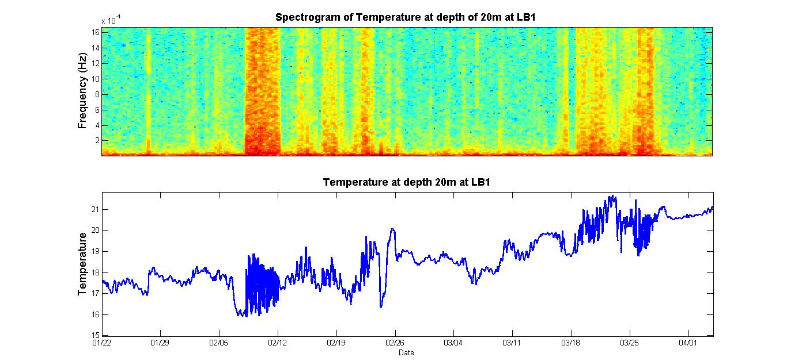
Notes:
High-frequency oscillations seen in temperature at 20m over LB1 (from thermistor chain) during J2 and 2nd half of March.

Slide 48
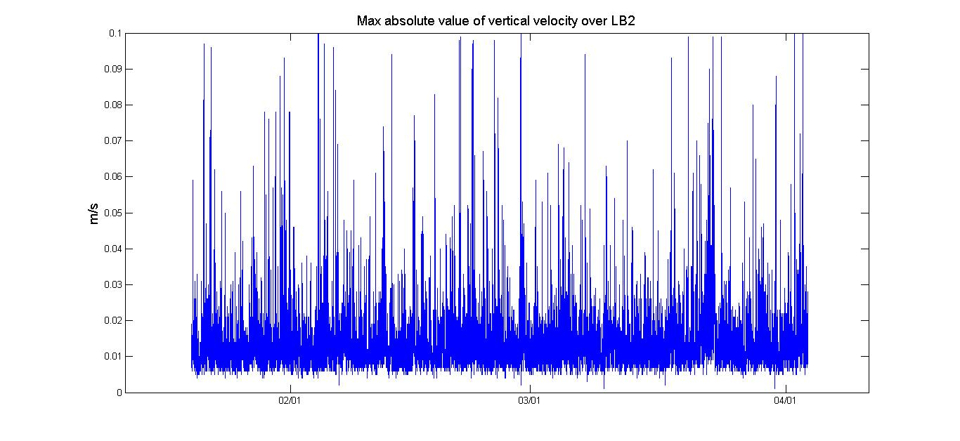
Observations Max abs value of vertical velocity over LB2
Notes:
This shows that internal waves are present throughout the duration of the field program—not just during J2 and “Late March” The point is that they are always there, but the “summer front” configuration allows them to propagate shoreward.

Slide 49
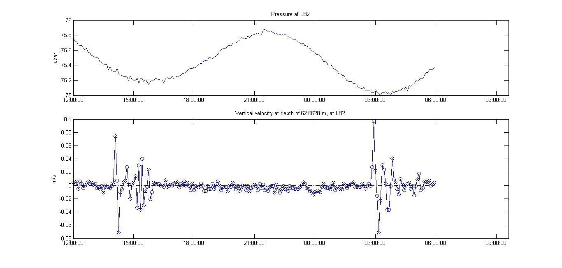
Observations Zoom in on internal wave packets Feb 4 – 5 over LB2
Notes:
Zoom in on Feb 4 to Feb 5 to see the timing of the internal wave packets relative to the tide.

Slide 50
Notes:
High-frequency oscillations seen in temperature at 20m over LB1 (from thermistor chain) during J2 and 2nd half of March. Why not in January during J1? Not stratified at LB1. (Maybe shelf front was seaward of LB1 at that time…)

Slide 51
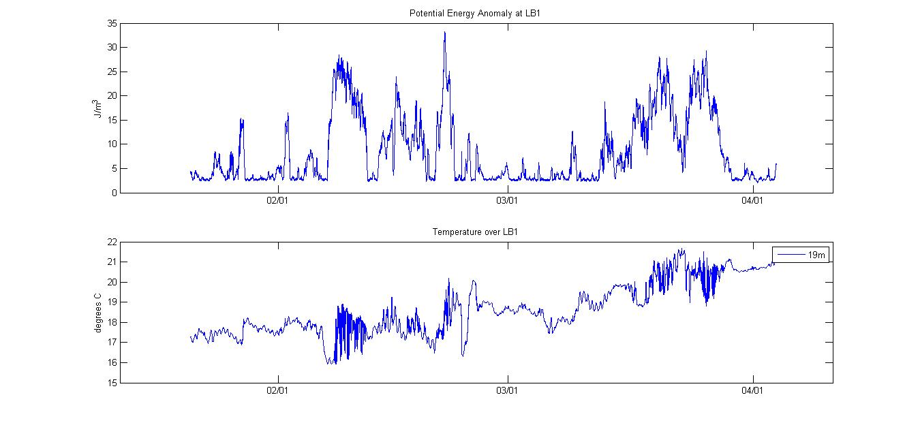
PEA = (1/h) ∫ g (<ρ>-ρ(z))z dz [J/m³]
Notes:
See: not stratified at LB1 in late January, during J1. (Maybe shelf front was seaward of LB1 at that time…)

Slide 52
Papers Distribution of Chl-a in Space and Time
Observations
Where and when did we see blooms on the shelf/slope
Satellite images
Time Series of Chl-a (from moorings, thermistor chain)
Transects of Chl-a (from gliders, Acrobat)
Profiles from Savannah casts
T-S plots color-coded with Chl-a (provides another view)
Correlate to physical processes, nitrate distribution (in space/time)
Estimate export
Notes:
Challenging because Chl-a is being produced/consumed, advected, falling to bottom, kicked-up from bottom (resuspension of sediment)

Slide 53
Papers Distribution of Nitrate in Space and Time
Observations
Where and when did we see nitrate on the shelf/slope
Transects of measured nitrate (Acrobat)
Transects of estimated nitrate (gliders)
T-S plots color-coded with nitrate (provides another view)
For each instance of up-slope transport, correlate to physical processes
Wind-driven Ekman flow
Internal waves
Presence of Gulf Stream features (meanders/filaments/jets)
Estimate transport (up-slope, shoreward)
Notes:
Challenging because Chl-a is being produced/consumed, advected, falling to bottom, kicked-up from bottom (resuspension of sediment)

Slide 54
References
Atkinson, L. P., E. Oka, S. Y. Wu, T. J. Berger, J. O. Blanton, and T. N. Lee, 1989. Hydrographic variability of southeastern United States shelf and slope waters during the Genesis of Atlantic Lows Experiment: Winter 1986, J. Geophys. Res. 94(C8), 10699–10713.
Atkinson, L.P., J.L. Miller, T.N. Lee, W.N. Dunstan, 1996. Nutrients and chlorophyll at the shelf break
off the southeastern United States during the Genesis of Atlantic Lows Experiment: Winter 1986. J.
Geophys. Res. 101: 20565-20578.
Bane J. M. and D. A. Brooks, 1979. Gulf Stream meanders along the continental margin from the Florida Straits to Cape Hatteras. Geophysical Research Letters, 6,280-282.
Bane J.M., Osgood K.E., 1989. Wintertime air-sea interaction processes across the Gulf stream. J Geophys Res 94:10755–10772.
Jahnke, R.A. and J.O. Blanton, 2010. The Gulf Stream, section 3.3 in Carbon and Nutrient Fluxes in Continental Margins, Springer.
Lee, T.N., L.P. Atkinson, R. Legeckis, 1981. Observations of a Gulf Stream frontal eddy on the Georgia
continental shelf, April 1977. Deep-Sea Res., 28: 347-378.

Slide 55
References
Lee, T.N., J.A. Yoder, L.P. Atkinson, 1991. Gulf Stream frontal eddy influence on productivity on the
southeast US continental shelf. J. Geophys. Res. 96: 22,191-22,205.
Miller, J. L., 1994. Fluctuations of Gulf Stream frontal position between Cape Hatteras and the Straits of
Florida, J. Geophys. Res., 99:5057-5064.
Oey, L., L.P. Atkinson, J.O. Blanton, 1987. Shoreward Intrusion of Upper Gulf Stream Water onto the U.S. Southeastern Continental Shelf. J. Phys. Oceanogr., 17, 2318–2333.
Osgood, K.E., J.M. Bane, and W.K. Dewar, 1987. Vertical velocities and dynamical balances in Gulf Stream meanders. Journal of Geophysical Research, 92(c12),13029-13040,13211.
Ryan, J.P. and J.A. Yoder, 1996. Long-term mean and event-related pigment distributions during the
unstratified period in South Atlantic Bight outer margin and middle shelf waters. Cont. Shelf Res. 16:
1165-1183. doi:10.1016/0278-4343(95)00062-3.
Vlasenko, Stashchuk, and Hutter, 2012. Baroclinic Tides, Cambridge University Press.

